Slide 1



KBTG x MeowCode
Say “Hello”
Machine Learning
Jetsukda Janthornthao
AI Engineer @ Ztrus
x

Slide 2

What is Machine Learning (ML)
Main types of Machine Learning
Steps in a full ML project
Machine Learning Framework
Class Overview

Slide 3

Scikit-Learn (sklearn)
Scikit-Learn is a python machine learning library.
Built on NumPy and Matplotlib (and Python).
Has many in-built machine learning models.
Methods to evaluate your machine learning models.
https://scikit-learn.org/stable/

Slide 4

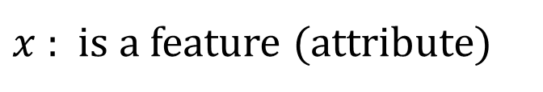
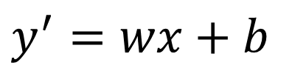
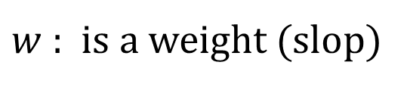
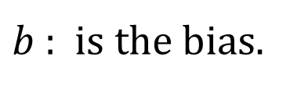
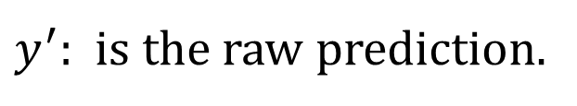
Linear Regression
Simple Linear Regression
Multiple Linear Regression
$$y^{′}=wx+b$$
$$y^{′}=w_{1}x_{1}+w_{2}x_{2}+…+w_{n}x_{n}+b$$
$y^{′}$: is the raw prediction.
$w$ : is a weight (slop)
$x$ : is a feature (attribute)
$b$ : is the bias.

Slide 5
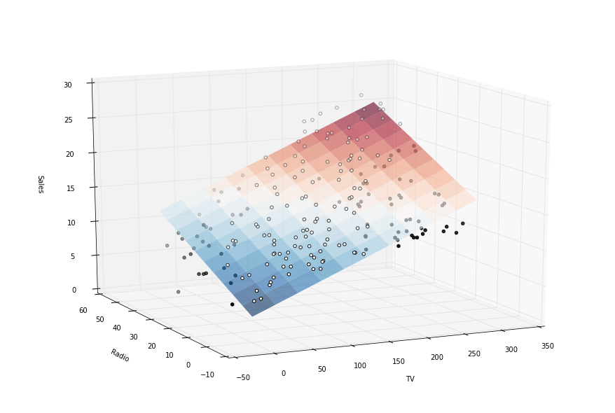
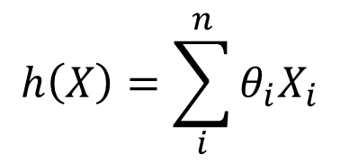
Understanding Linear Regression Algorithm
$$h\left(X\right)= θ_{0}+θ_{1}X_{1}+θ_{2}X_{2}+ θ_{3}X_{3}+…+θ_{n}X_{n}$$
$$h\left(X\right)=\sum_{i}^{n}{θ_{i}X_{i}}$$
* n features -> (n+1) features

Slide 6
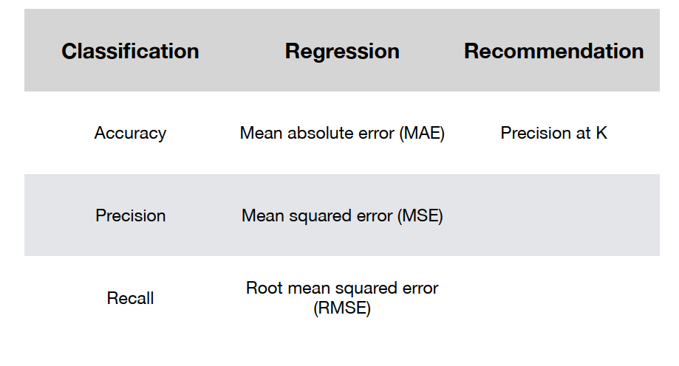
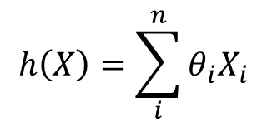
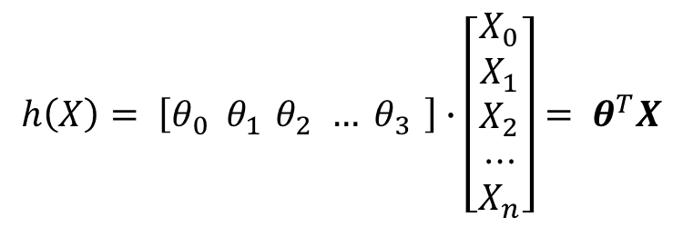
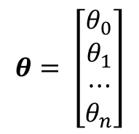
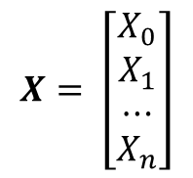
Understanding Linear Regression Algorithm
$$h\left(X\right)= θ_{0}+θ_{1}X_{1}+θ_{2}X_{2}+ θ_{3}X_{3}+…+θ_{n}X_{n}$$
$$h\left(X\right)=\sum_{i}^{n}{θ_{i}X_{i}}$$
$$Vector Form of Linear Regression$$
$$θ= \left[\begin{matrix}θ_{0} \\ \begin{aligned}θ_{1} \\ ⋯\end{aligned} \\ θ_{n}\end{matrix}\right]$$
$$X= \left[\begin{matrix}X_{0} \\ \begin{aligned}X_{1} \\ ⋯\end{aligned} \\ X_{n}\end{matrix}\right]$$
$$h\left(X\right)= \left[θ_{0} θ_{1 }θ_{2 }… θ_{3 }\right]∙\left[\begin{matrix}X_{0} \\ \begin{aligned}X_{1} \\ X_{2} \\ ⋯\end{aligned} \\ X_{n}\end{matrix}\right]= θ^{T}X$$

Slide 7
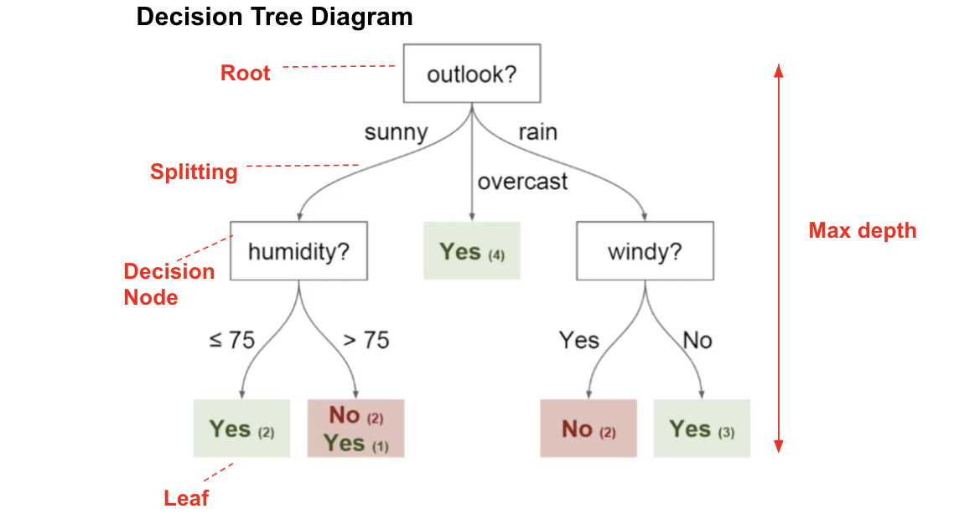
Decision tree
Decision tree is a very old and simple idea. But it is most popular ML algorithm
Easy to understand
Easy to implement
Can be used for both classification and regression problems

Slide 8
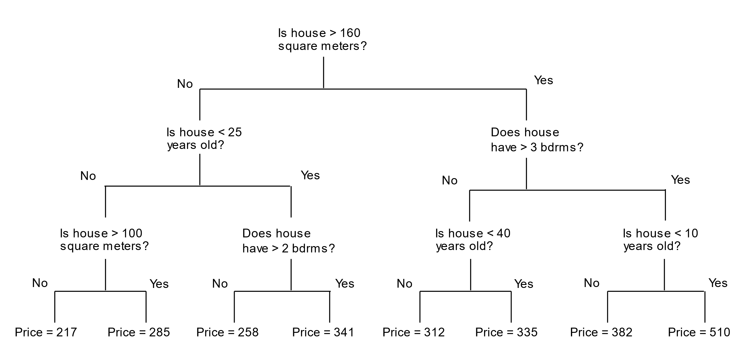
Decision tree: Regression

Slide 9
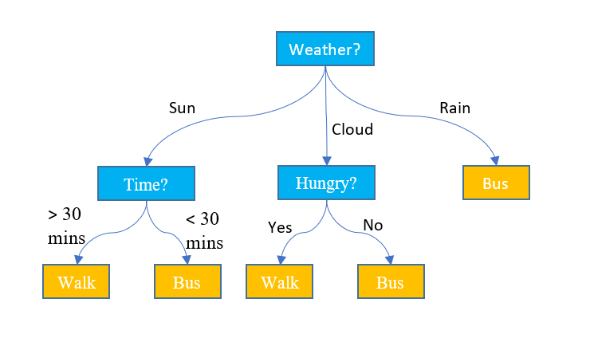
Decision tree: classification

Slide 10
Reference
Machine Learning Glossary
zero-to-mastery-ml
machinelearning-datascience
Hands-On Machine Learning with Scikit-Learn, Keras, and TensorFlow
handson-ml2
scikit-learn: Save and Restore Models
Introduction to Machine Learning Algorithms: Linear Regression

